Slide 1


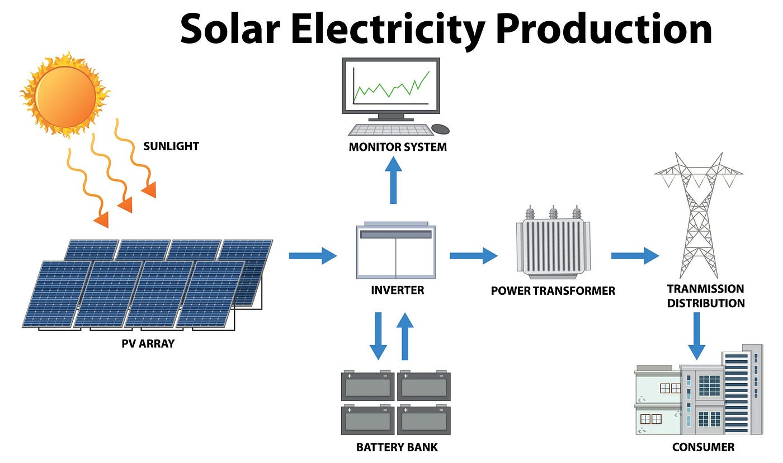
MLA0413- Deep Learning for Complex Data Mining
SOLAR POWER GENERATION FORECASTING USING ARTIFICIAL NEURAL NETWORK
Workdone by:
N. PAVAN SAI(192225023)

Slide 2

ABSTRACT
This project aims to develop an accurate forecasting model for solar power generation using Artificial Neural Networks (ANN). By leveraging historical data on solar irradiance, weather conditions, and past power generation, the model captures complex nonlinear relationships to predict future solar output. The ANN is trained and evaluated using performance metrics like Mean Absolute Error (MAE) and Root Mean Square Error (RMSE). Results show that the ANN model significantly improves forecast accuracy over traditional methods, highlighting its potential for enhancing energy management and grid efficiency in renewable energy systems.

Slide 3

INTRODUCTION
Solar power generation forecasting using artificial neural networks (ANNs) is an innovative approach to predicting the amount of electricity that will be generated by solar power systems.
Leveraging the capabilities of ANNs, which are designed to recognize patterns and learn from data, enhances the accuracy of forecasts.
Precise predictions are crucial for integrating solar power into the grid, managing energy resources efficiently, and ensuring reliable power supply.
The use of ANNs in solar forecasting addresses challenges posed by the variability of solar energy due to weather conditions and other factors.
This technology represents a significant step towards optimizing renewable energy utilization and advancing sustainable energy solutions.

Slide 4

PROBLEM STATEMENT
Accurate forecasting of solar power generation is critical for the efficient integration of solar energy into the electrical grid, resource management, and ensuring a reliable power supply. Traditional forecasting methods often struggle with the inherent variability and intermittency of solar power due to weather conditions, seasonal changes, and other environmental factors. These limitations can lead to inefficient energy distribution, increased operational costs, and challenges in maintaining grid stability.
This project aims to address these challenges by developing an advanced forecasting model using artificial neural networks (ANNs). By leveraging the pattern recognition and learning capabilities of ANNs, the goal is to enhance the accuracy of solar power generation predictions, thereby improving grid integration, optimizing energy resource management, and supporting the transition to a more sustainable energy future. The project will involve data collection, model training, and validation to ensure robust and reliable forecasting performance.

Slide 5
DATA ANALYTICS
Data Collection: Gather historical solar power data from existing panels and weather data (sunlight intensity, temperature, etc.). Time-series and geographical data (latitude, longitude) are also collected to capture patterns and regional influences.
Data Preprocessing: Clean and normalize data to handle missing values and scale features uniformly. Feature engineering includes creating new variables like weather indices and time-based features.
Exploratory Data Analysis (EDA): Visualize relationships using plots, analyze correlations, and decompose time-series data to understand patterns and trends.
Model Development: Split data into training, validation, and test sets. Choose appropriate ANN architecture (e.g., feedforward, RNNs, LSTM) and optimize hyperparameters for improved performance.
Model Training: Train the ANN using optimization algorithms like Adam or SGD. Validate performance on a separate validation dataset to fine-tune parameters and prevent overfitting.
Model Evaluation: Assess model accuracy using metrics like MAE and RMSE on a test dataset. Iterate and refine the model to achieve accurate solar power generation forecasts for grid integration and resource management

Slide 6
ENVIRONMENTAL SET UP
Hardware requirements include high-performance CPUs or GPUs for computational tasks, sufficient storage for large datasets, and ample RAM for smooth processing.
Software setup focuses on Python for data handling, modelling using TensorFlow or PyTorch for ANNs, and libraries like Pandas, NumPy, Matplotlib, and Seaborn for analysis and visualization.
Data sources include historical solar power and weather data (sunlight intensity, temperature, etc.), obtained from reliable sources or APIs, along with geographical data (latitude, longitude) for spatial analysis.
Data preprocessing involves cleaning, normalization, and feature engineering to optimize data for accurate forecasting models.
Establishing this setup enables effective use of ANNs to enhance solar power forecasting accuracy, aiding grid integration and sustainable energy management efforts.

Slide 7
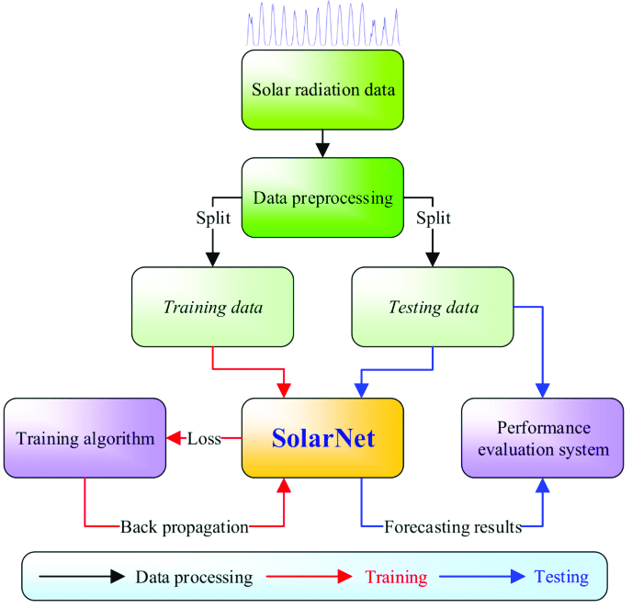
DATA FLOW DIAGRAM

Slide 8

CODE
import pandas as pd
import numpy as np
import tensorflow as tf
from keras.layers import Dense, Activation, BatchNormalization, Dropout
from keras import regularizers
from keras.optimizers import RMSprop, Adam, SGD
import datetime
import matplotlib.pyplot as plt
import seaborn as sns
dts = pd.read_csv('data/solarpowergeneration.csv')
dts.head(10)
X = dts.iloc[:, :-1].values
y = dts.iloc[:, -1].values
print(X.shape, y.shape)
y = np.reshape(y, (-1,1))
Y.shape

Slide 9
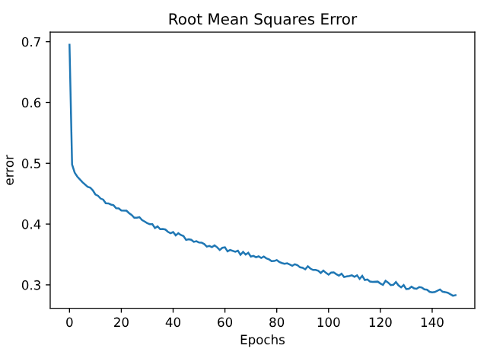
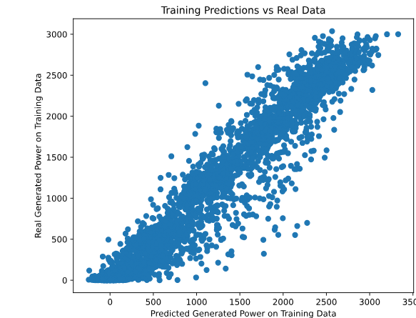
FINAL OUTPUT

Slide 10

CONCLUSION
This study explores the use of artificial neural networks (ANNs) for forecasting solar power generation using historical data. The ANN model accurately predicts solar energy output by incorporating factors such as time of day, weather conditions, and geographical parameters. Data preprocessing and feature selection helped capture complex relationships, resulting in high predictive performance as indicated by metrics like RMSE and R² score. These findings are crucial for optimizing energy management, enhancing grid stability, and integrating renewable energy sources. Future research can improve accuracy by exploring advanced neural network architectures and real-time data integration, promoting sustainable energy practices.

Slide 11
REFRENCES
Zhang, J., Wu, S., & Cui, T. (2020). Review on Solar Power Forecasting Techniques: State-of-the-Art and Challenges. Energies, 13(20), 5403. DOI: 10.3390/en13205403
Elshehaly, M., & Sasaki, S. (2019). Short-term solar power forecasting using machine learning approaches: A review. Renewable and Sustainable Energy Reviews, 107, 461-470. DOI: 10.1016/j.rser.2019.03.014
Hodge, B. M., & Ma, H. (2019). Review of statistical and machine learning models for short-term solar power forecasting. Solar Energy, 195, 678-688. DOI: 10.1016/j.solener.2019.10.065
Wang, B., Wang, X., & Li, W. (2020). Solar Power Forecasting Using Machine Learning Methods: A Comparative Study. IEEE Access, 8, 147896-147906. DOI: 10.1109/ACCESS.2020.3017565
Jia, H., Wang, J., & Lei, X. (2021). Short-term solar power forecasting using a novel hybrid ensemble learning method based on metaheuristic optimization. Applied Energy, 284, 116321. DOI: 10.1016/j.apenergy.2020.116321

Slide 12
